Slide 1
Title - Einstein Analytics - Salesforce
Problem Statement
Targeting – Convert prospects into clients:
Convert ‘prospects’ into new clients. Segment the incoming funnel based on intent and leverage this
data to deliver relevant messages. Metric – Lead Conversion Ratio.

Slide 2
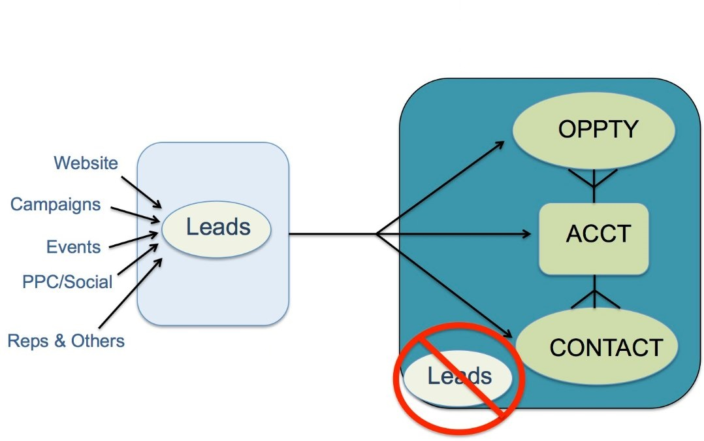
Design Architecture

Slide 3
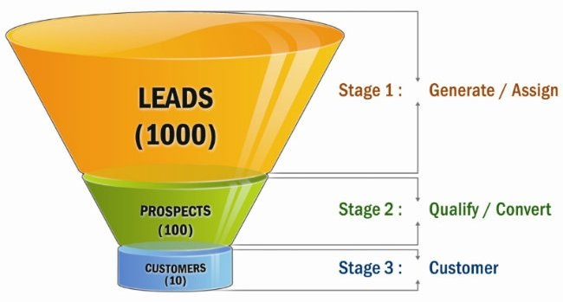
Design Architecture

Slide 4
Abstract
Lead Conversion in Salesforce
When you qualify a lead, you can convert the lead record into an opportunity. You’ll then work your opportunity until you close the deal either by completing it or canceling it.
Qualifying a lead indicates that you believe that the lead has a use for and interest in your products, and that a sale to the lead is a definite possibility.
Some businesses choose to qualify leads more quickly than others. The exact criteria for qualifying and converting leads is part of your company’s unique business process.

Slide 5
Solution Approach & Business Impact
Using Einstein Analytics and Discovery
Einstein Analytics is reliable, convenient, and gets up and running much more quickly than traditional solutions.
The platform simplifies the preparations, analyses and visualizations that turn complex raw data into intelligence, and investment into growth.
Get data analysis directly from Salesforce — or any other data source — from across your business.
Now you can instantly explore information, find insights, and take actions that help your whole team move forward.
Make sales analytics simple and intuitive — uncover new opportunities, see into pipeline, and track team performance using prebuilt dashboards that show crucial business metrics and KPIs.
Build custom analytics applications to solve issues for any company, in any industry. Discover and implement partner apps built on the platform that are already saving businesses time and money.

Slide 6
Solution Approach & Business Impact
Using Einstein Analytics and Discovery
Give your employees and partners a consistent view of data and access to new insights.
Embed dashboards across the Customer Success Platform with Einstein Analytics — from Sales Cloud to Service Cloud.
No more waiting for IT to install hardware and optimize software before you can ask questions or take action. With Salesforce as your CRM, analytics is built into your data.
Find hidden insights faster with Einstein Analytics, the business analytics tool built for the way you work.
Find hidden insights and sales opportunities in your business and customer data that you can take action on, right from within Salesforce.

Slide 7
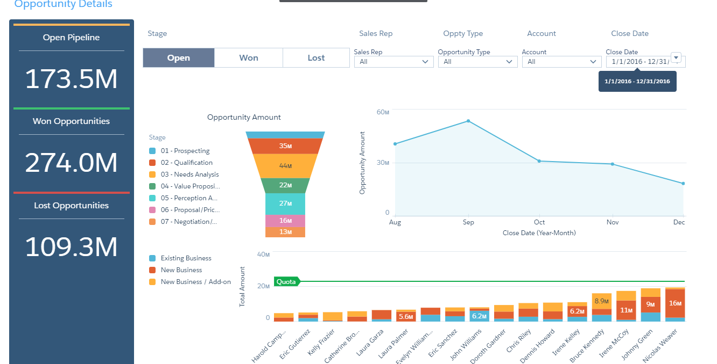
Einstein Analytics Overview

